Slide 1



HACK MATRIX HACKATHON
TITLE PAGE
PROJECT TITLE :
BioDex - Gamified Urban Wildlife Tracker
Under Wildlife Sighting Reporter Problem ID: HM44
TEAM NAME :
Debug Duo
TEAM MEMBERS :
Prateek Das ID:25BCE10599
Kumari Shikha Kushwaha ID:25BCE11243

Slide 2

PROBLEM STATEMENT
Describe the problem clearly .
Urban biodiversity data is incredibly scarce because everyday citizens lack a simple, structured, and engaging way to contribute local wildlife observations.
Who is affected by this problem .
Environmental researchers tracking urban ecosystems, and local communities disconnected from their surrounding wildlife.
Why this problem is important ?
Without crowdsourced data, it is impossible to monitor species decline, invasive species spread, or the general ecological health of our immediate urban environments.

Slide 3
EXISTING SOLUTIONS AND GAPS
List of existing Solutions (if any)
Complex academic portals (like eBird) and unstructured posts in local community WhatsApp/Facebook groups.
Mention their Limitations
Academic tools have steep learning curves that deter casual users. Social media posts lack standardized GPS tagging and searchable databases.
Explain the gap your project will address
BioDex bridges the gap by turning ecological data collection into an engaging, gamified experience for the everyday citizen, automatically capturing standard GPS and timestamp data without extra effort.

Slide 4
PROPOSED SOLUTION
Explain your solution clearly .
A mobile-responsive web app where users photograph local wildlife, log it with automatic GPS coordinates, and view community sightings on an interactive map.
List key features
A photo-first sighting submission form, an interactive real-time community map, and a gamified "Species Explorer" badge system, secure user authentication.
Explain how it solves the problem
It removes the friction of data entry and introduces a "collect-them-all" motivation, seamlessly generating rich, localized biodiversity data.

Slide 5
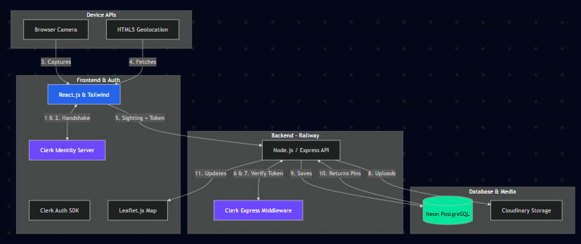
SYSTEM ARCHITECTURE
Include architecture diagram
Mention main components
(Frontend, Backend, Database, APIs)
Frontend: React.js & Clerk Auth SDK (Handles User Sign-in & Session Management)
Backend: Node.js / Express.js with Clerk Middleware
Database: PostgreSQL via Neon Tech (Relational Data) & Cloudinary (Image Storage)
APIs: HTML5 Geolocation API, Leaflet.js , Gemini API
Explain data flow briefly
The React client captures location and photo -> Photo goes to Cloudinary -> Backend receives Image URL + GPS data -> Saves to Neon Postgres Database -> Pushes data back to update the Leaflet map.

Slide 6
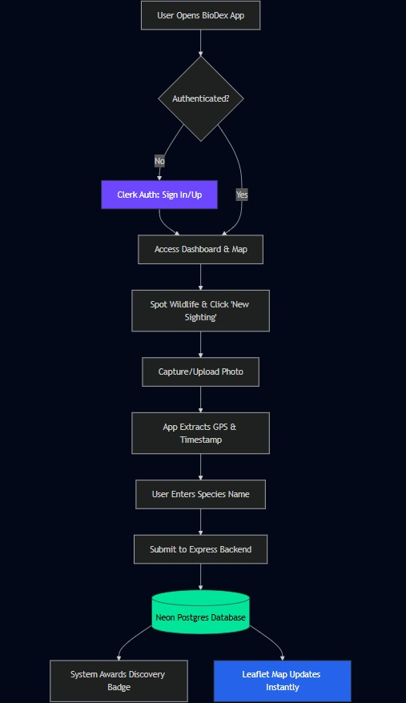
FLOWCHART / WORKING PROCESS
Show step-by-step working
Include user flow or system flow
Use a proper flowchart

Slide 7
TECH STACK
Frontend technologies
React (Vite) and Tailwind CSS - For rapid, responsive mobile-first UI development.
Backend technologies
Node.js with Express (Hosted on Railway) - For robust REST API creation and fast CI/CD deployment.
Database
Neon Tech (Serverless PostgreSQL) for sighting data, and Cloudinary for wildlife image storage.
Leaflet.js: Lightweight, open-source mapping without requiring API keys.
Clerk Authentication,Gemini API
HTML5 Geolocation API: Native browser support to easily capture accurate
coordinates.
Tools and APIs used and
reason for choosing each (1 line each)

Slide 8
IMPLEMENTATION PLAN
Step-by-step development plan
Scaffold UI and initialize Map.
Build photo upload and GPS capture logic.
Configure Clerk Auth & Middleware
Render dynamic pins on the map.
Modules or features to be built
Interactive Map View, Sighting Submission Form, Gamification/Badge Engine.
9:30 AM - 12:30 PM: Core React UI, Map setup, and Clerk Provider Integration.
12:30 PM - 3:30 PM: Form logic & Geolocation API.
3:30 PM - 5:30 PM: Styling and Testing
Timeline (if applicable)

Slide 9
EXPECTED OUTCOME / IMPACT
Expected results of the project
A functional prototype featuring an interactive map populated with wildlife pins and a working submission form capturing real location data.
Benefits to users
Citizens get a fun, engaging way to interact with nature, learn about local species, and earn digital rewards.
Real-world impact
Creates a valuable, crowdsourced dataset of urban biodiversity that can be exported for environmental research and local conservation planning.

Slide 10
FUTURE SCOPE AND CONCLUSION
Future improvements
Integrating an AI Vision model to automatically identify the animal in the uploaded photo, reducing user entry error.
Final summary
Expanding to a nationwide platform with regional leaderboards and partnerships with schools for environmental education.
Scalability of the project
BioDex proves that by combining accessible mapping tech with gamified user experiences, we can solve the urban biodiversity data shortage one photo at a time. Expanding Clerk to include multiple social logins (GitHub, Apple) for frictionless onboarding.

